Slide 1
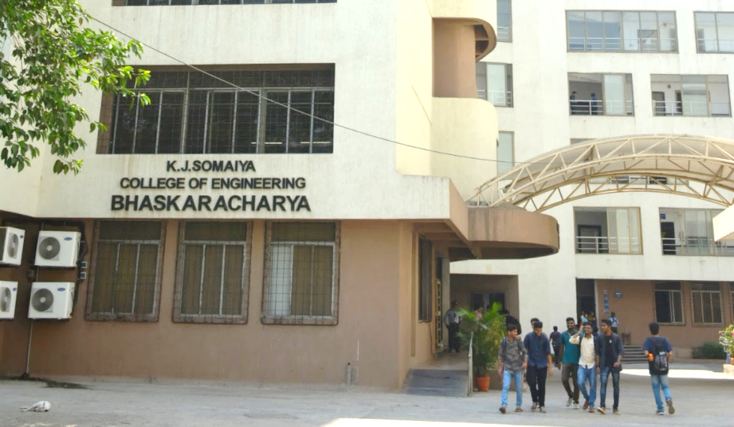
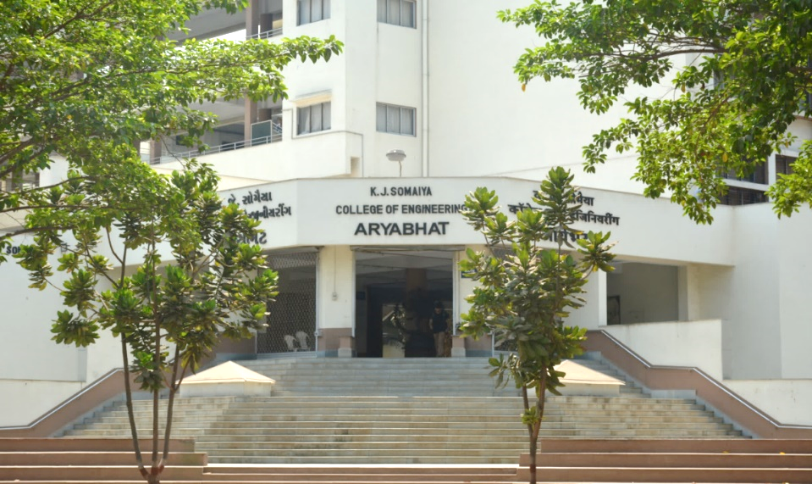
K J Somaiya College of Engineering, Mumbai-77
(Constituent college of Somaiya Vidyavihar University)
Course: Engineering Mechanics
Module 1.1: General force system
Dr. Ramola Sinha
Room no. A307
(Mechanical Engineering Department, KJSCE, SVU)

Slide 2
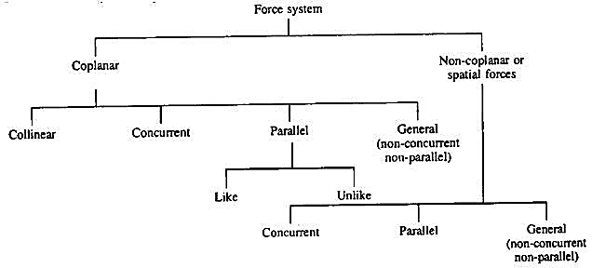

Slide 3
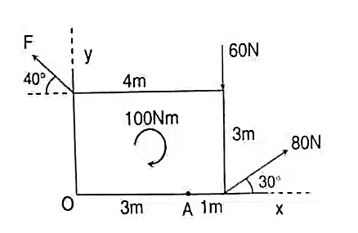
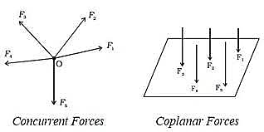
Types of force system
Concurrent force system
Parallel force system
General force syste

Slide 4
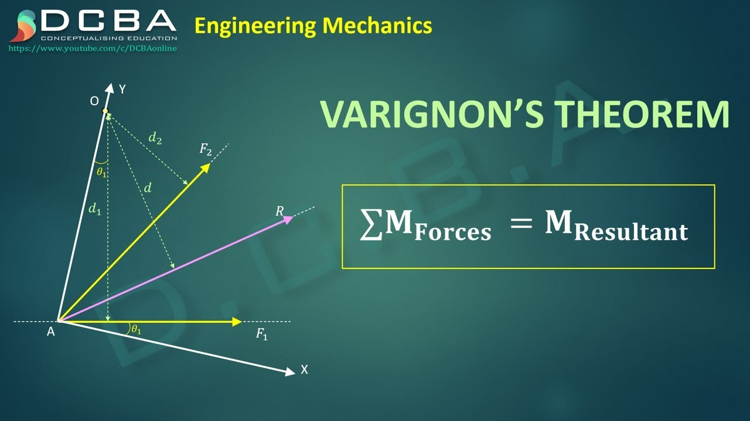
Varignon’s theorem

Slide 5
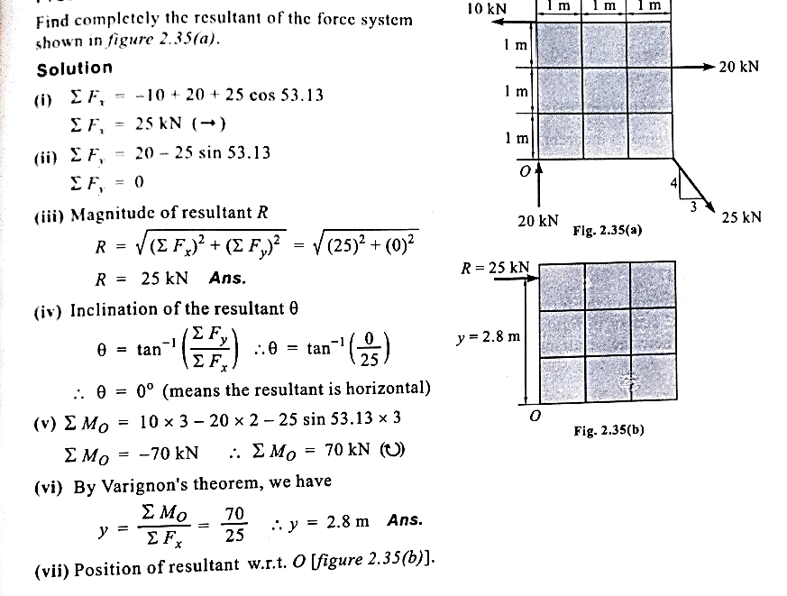

Slide 6
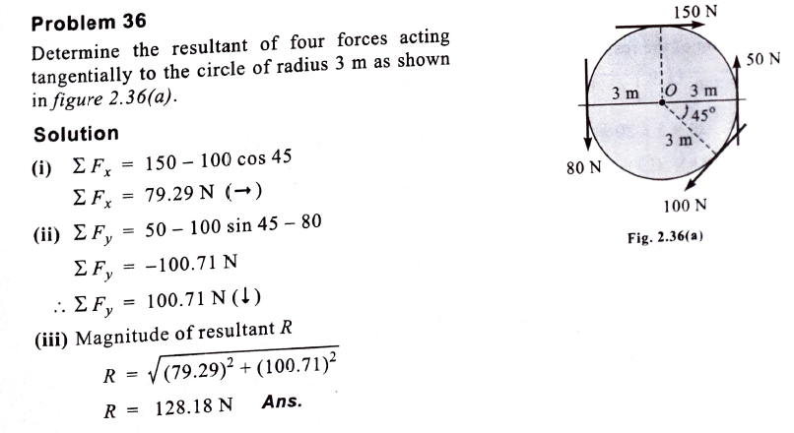
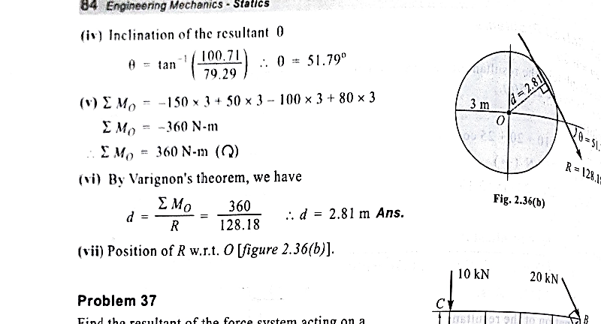

Slide 7
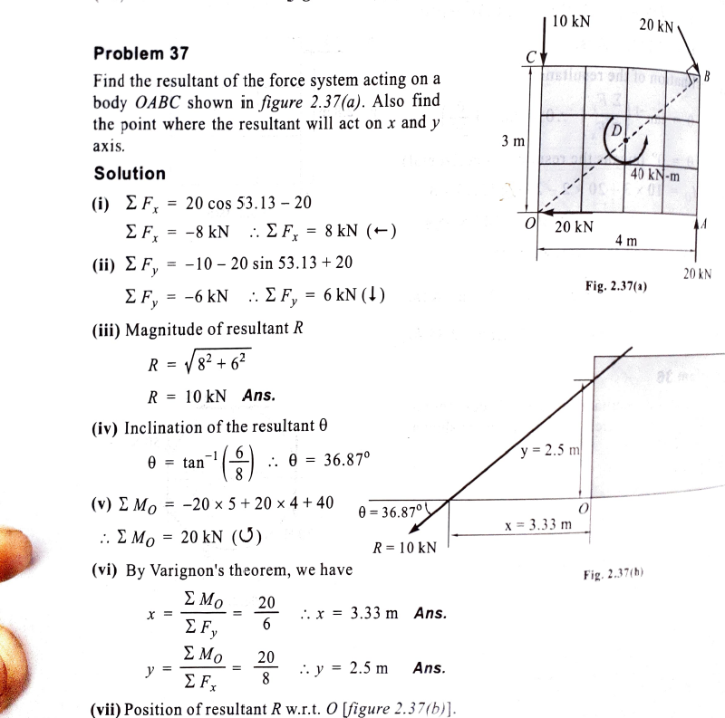

Slide 8
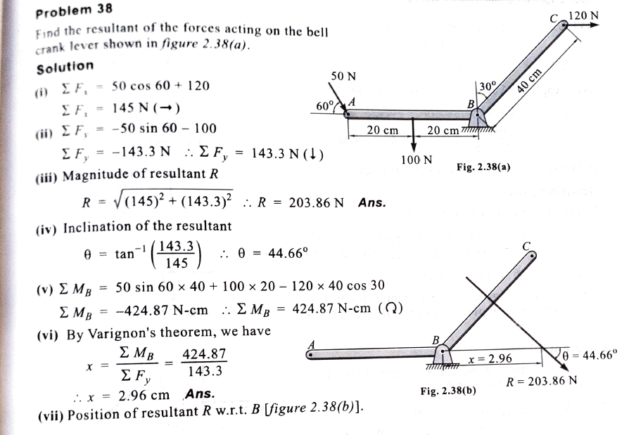

Slide 9
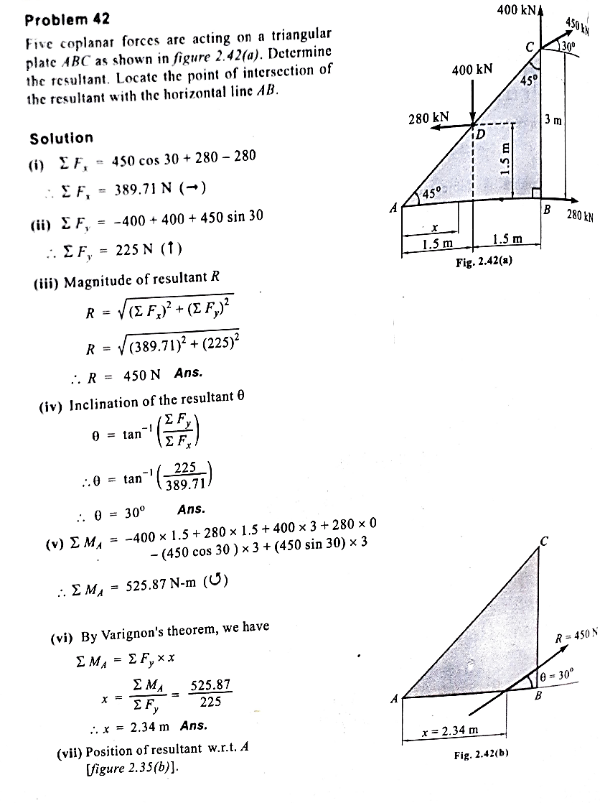

Slide 10
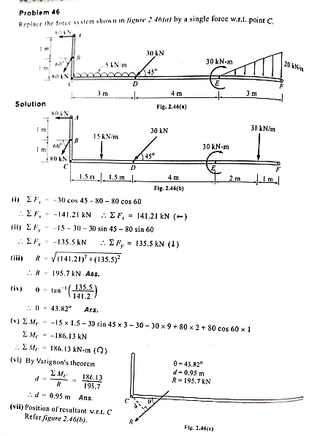

Slide 11
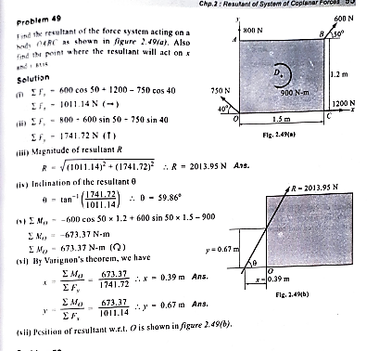

Slide 12
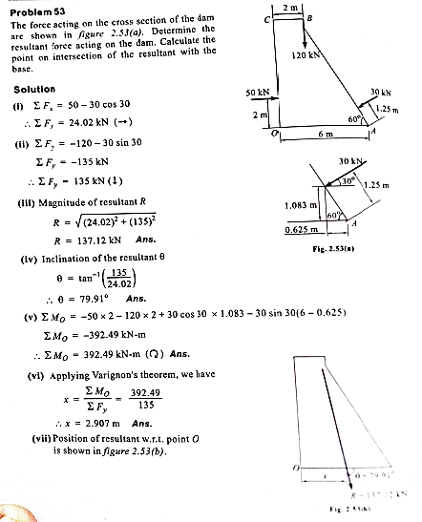

Slide 13
Any Question??

